Slide 1
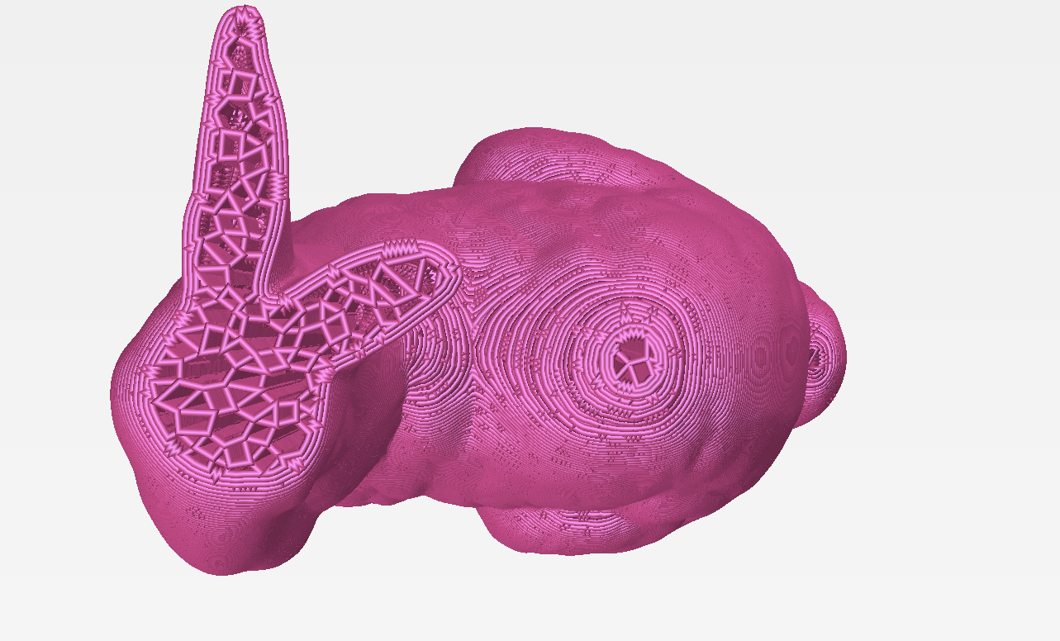
Continuous Toolpath Planning in a Graphical Framework for Sparse Infill Additive Manufacturing
Prashant Gupta*
Bala Krishnamoorthy*
Gregory Dreifus**
*Washington State University
**MIT

Slide 2
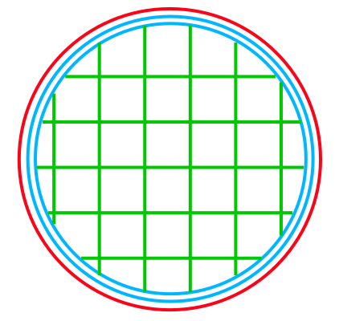
Sparse infill in 3D printing
Infill Region(Blue)
Sparse Infill mesh

Slide 3
Challenges
Discontinuous extrusion [Kuipers et al., 2019]
Input
Order
Leakage
Bulging
Crossover of extrusion paths
[Kuipers et al., 2019]
No Crossover
Crossover

Slide 4
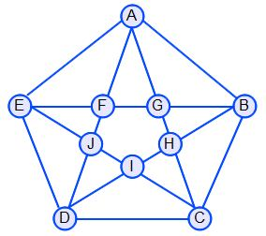
Challenges
Q: Can we create a framework to print continuously without crossover?
We can use Euler mesh, where each vertex is connected to even number of edges
But, Euler mesh for arbitrary domain with identical types of elements is challenging
NP-complete for triangulations with even parity (Aichholzer et al., 2014)
Crossover avoidance in mesh is still open
Euler Mesh

Slide 5
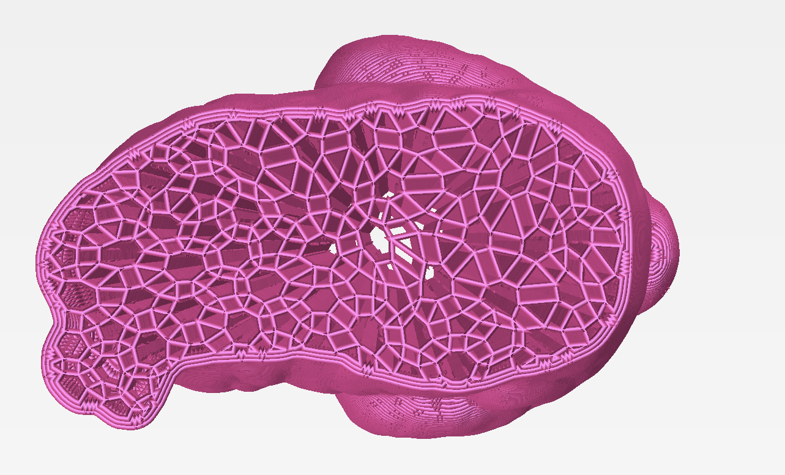
Our Contributions
Euler Transformation for any polygonal region with/out holes to generate Euler mesh
Generalized Euler Transformation that allows combinatorial and topological changes
Efficient continuous path planning framework for 3D printing using Euler Transformation
any geometry
holes
Algorithm for tool path with no crossover

Slide 6
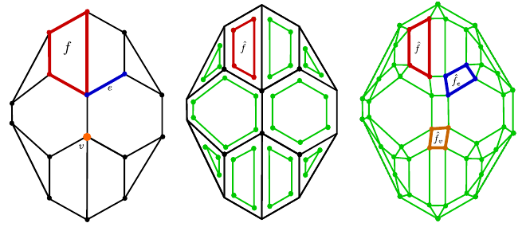
Euler Transformation*
a) Input Mesh
b) Mitered Offset
c) Joining
Can generate Euler mesh in polynomial Time for any input mesh
* G and Krishnamoorthy. Euler transformation of polyhedral complexes. 2018, arXiv:1812.02412

Slide 7
Properties of Euler Transformation (ET)
$ET\left(K\right)=\hat{K}$
Every vertex in $\hat{K}$ is connected to 4 other vertices
$\left|\hat{V}\right|=2\left|E\right|$
|$\hat{E}|=4\left|E\right|$
Total Euclidean length of the edges in $\hat{E}$ roughly doubles
$\left|\hat{F}\right|=\left|V\right|+\left|E\right|+|F|$
V,E,F: sets of vertices, edges, faces (polygons) in K

Slide 8
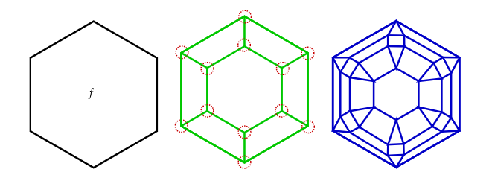
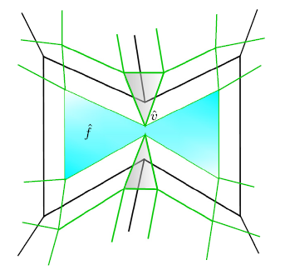
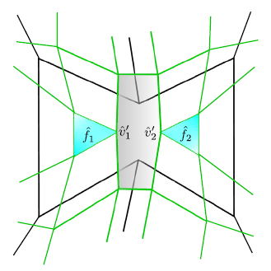
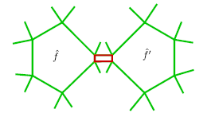
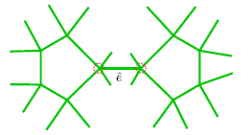
Properties of Euler Transformation (ET)
Euler mesh for any input Mesh
Generalized ET with combinatorial and topological changes
Combinatorial Change
Topological change

Slide 9
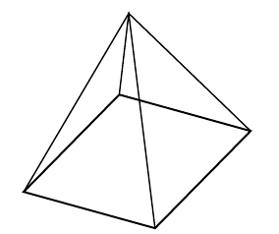
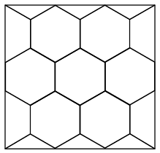
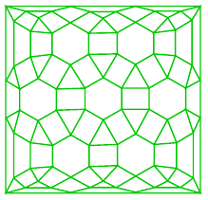
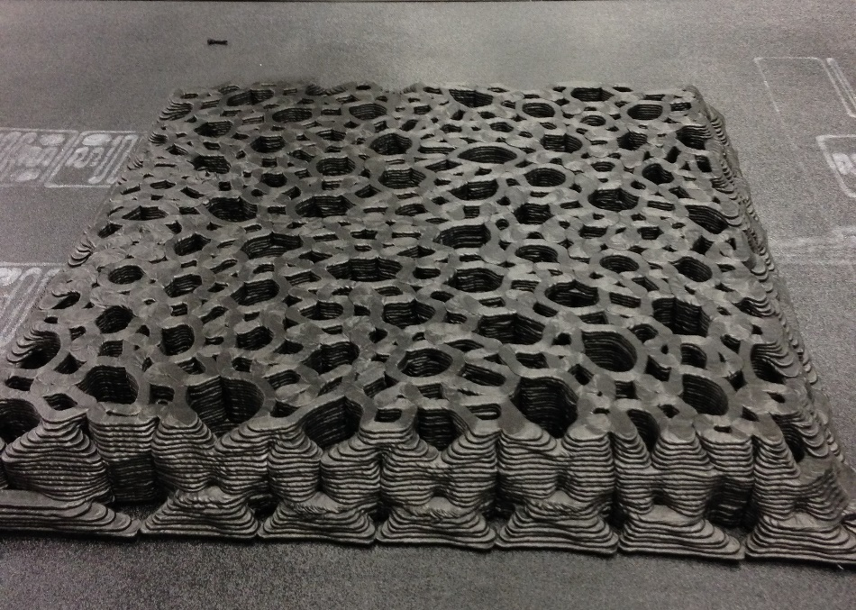
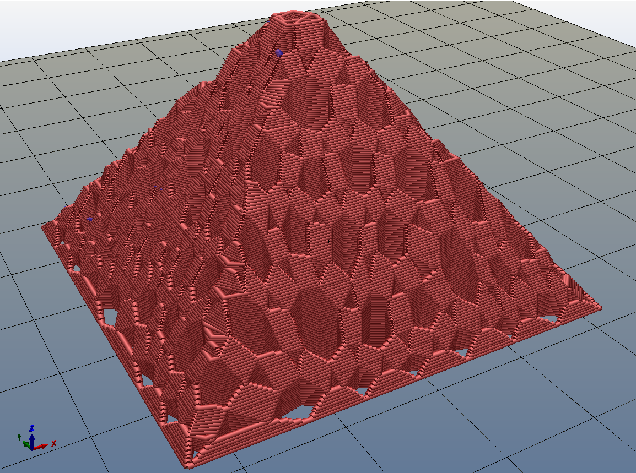
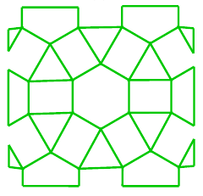
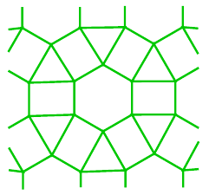
Outline of Our Framework
Input STL file
Union of projected polygons in each layer
Input mesh
Transformed Mesh
Printed Pyramid (Layers)
Preprint Pyramid
Patched Mesh
Clipped Mesh

Slide 10
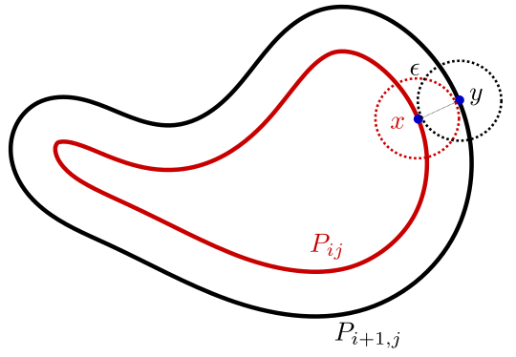
$ε$-Continuous Layers

Slide 11
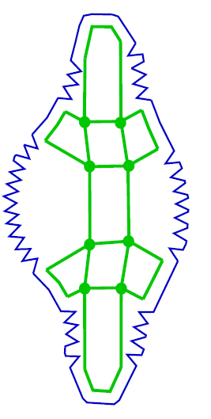
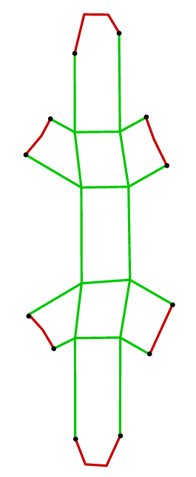
Support Perimeter
a) Patched Mesh
b) Support Perimeter (Blue)
Add regular perimeter around support perimeter to improve surface quality

Slide 12
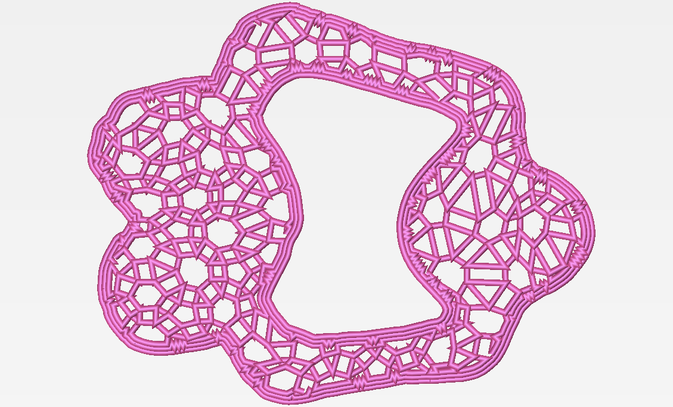
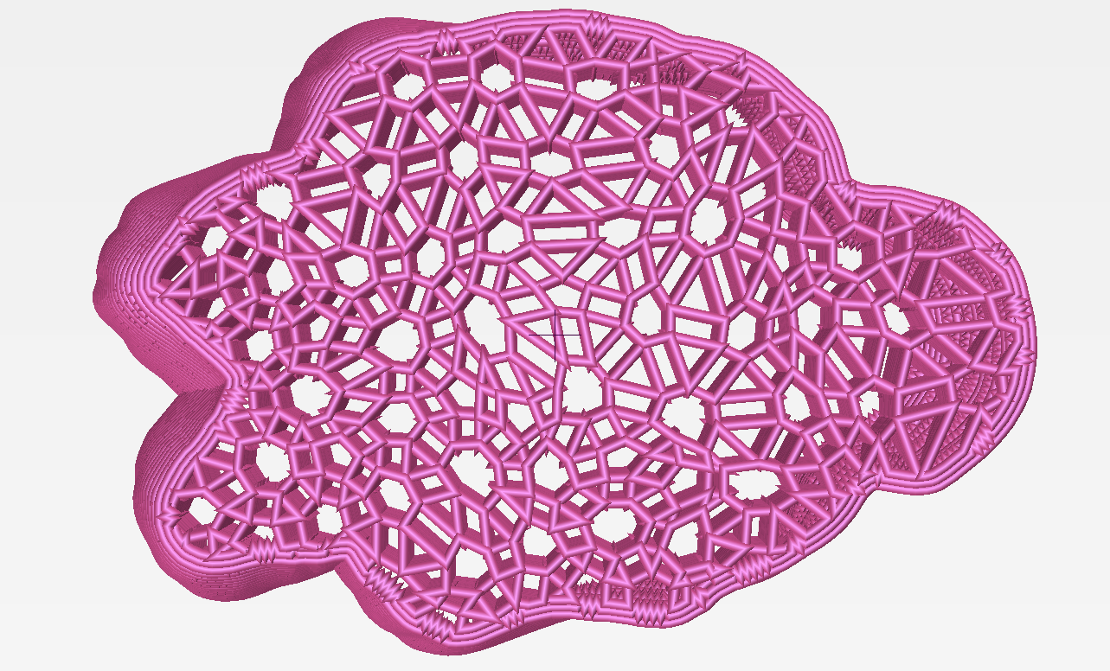
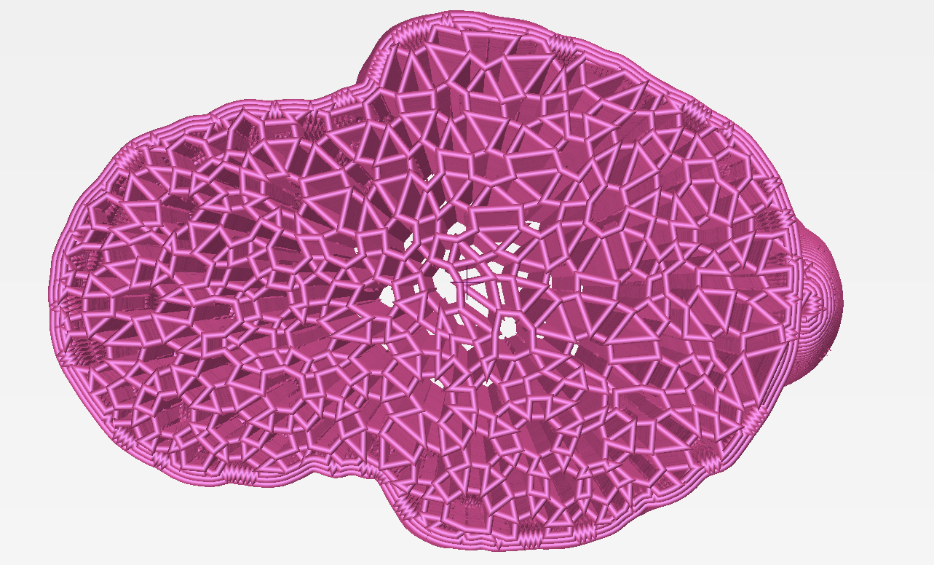
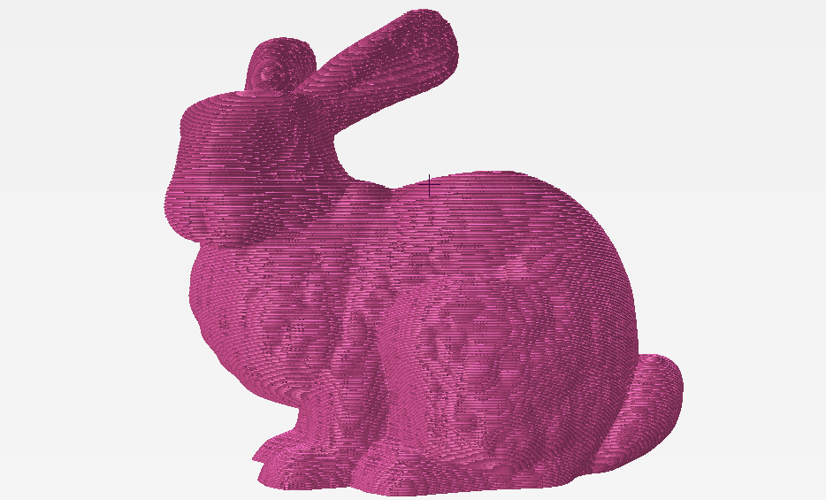
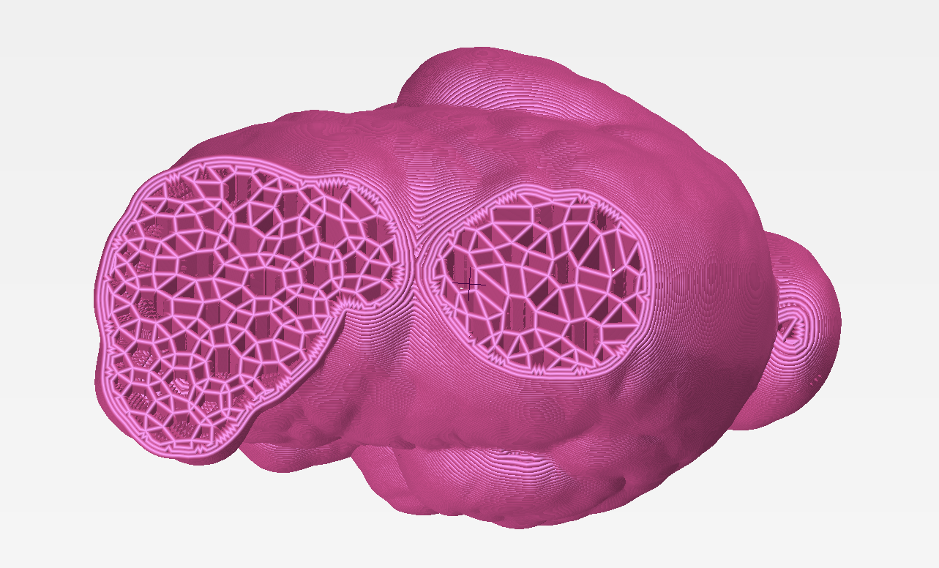
Example: Stanford Bunny

Slide 13
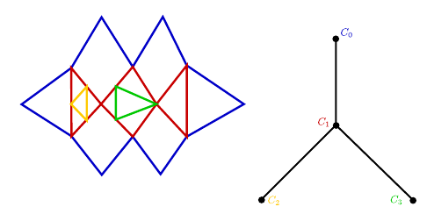
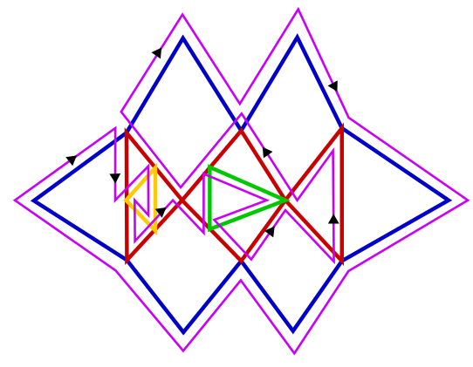
Algorithm for Toolpath with no crossover
a) Euler Mesh
b) Circuit Tree
c) Euler tour (pink), Restrictions (Black dots)

Slide 14
Toolpath for a Sample Layer

Slide 15
Open Problems
“Optimized” toolpath algorithm with no crossovers?
Mechanical properties of infill lattice under ET?
Continuous toolpath framework for surface mesh?
Non-planar 3D printing?
Thank You!

